Slide 1

More git commands
Sijumary Johnson

Slide 2
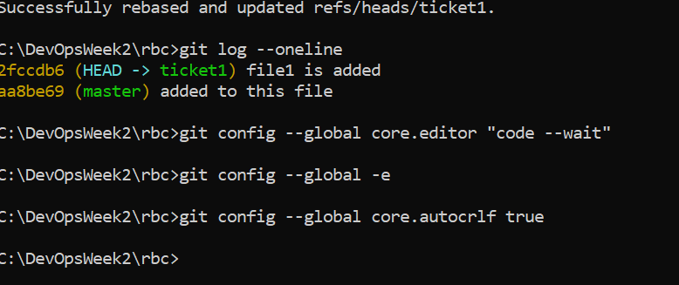
(screenshots) adding VS Code Editor

Slide 3
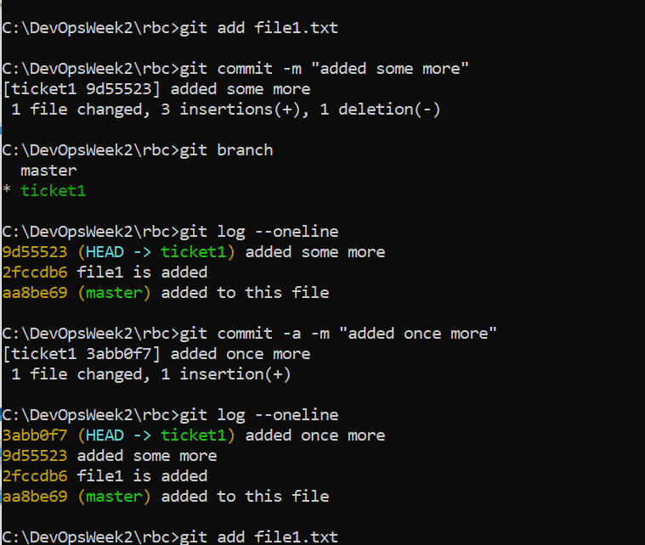
Git branch and log –oneline command

Slide 4
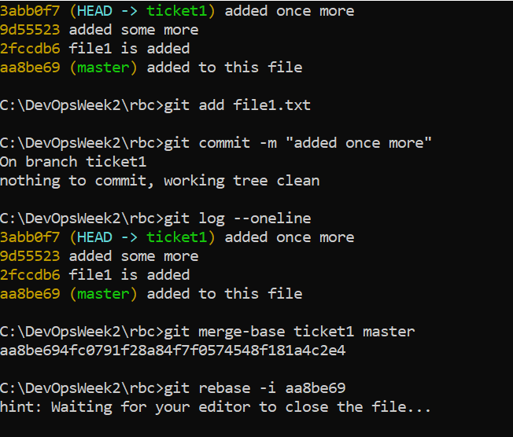
Merge-base and rebase command

Slide 5
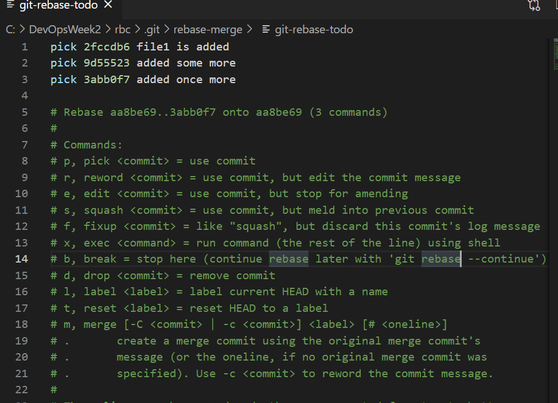
Contd… (this is in the editor)

Slide 6
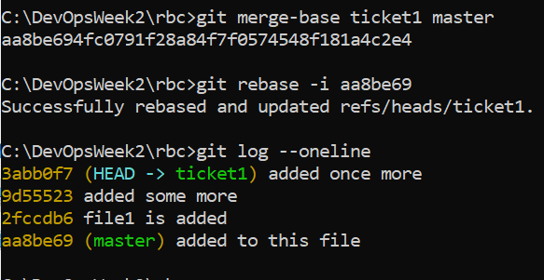
Contd… (rebased and updated)

Slide 7
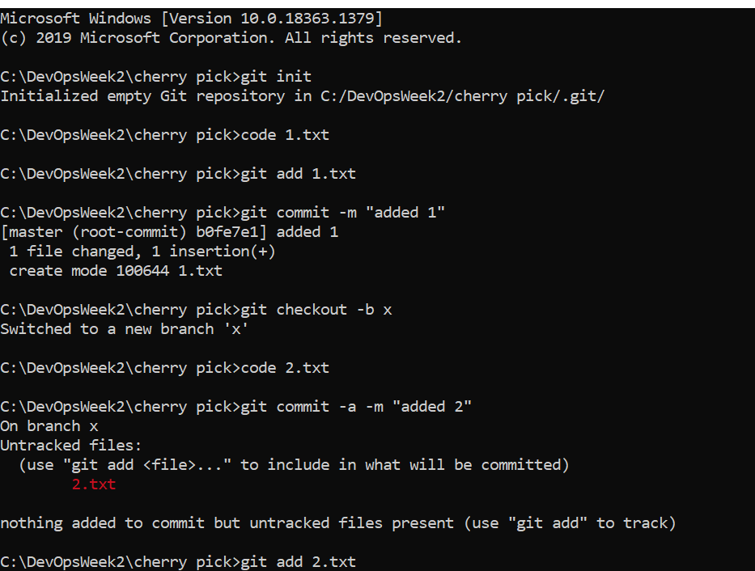
Cherry-pick commands (1)

Slide 8
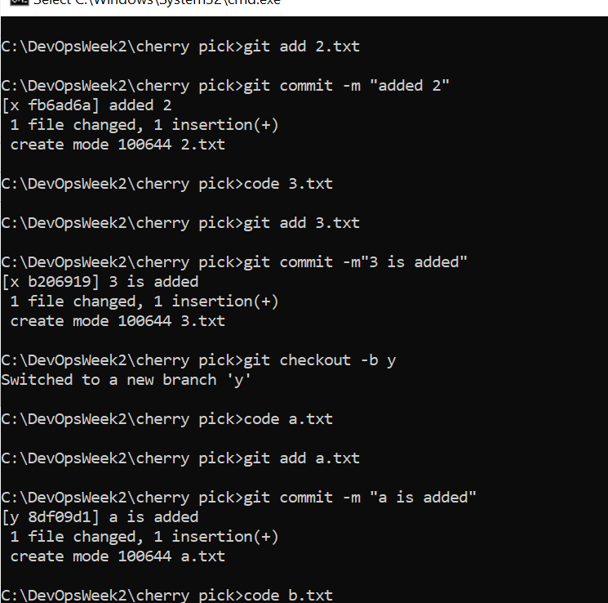
Cherry-pick (2)

Slide 9
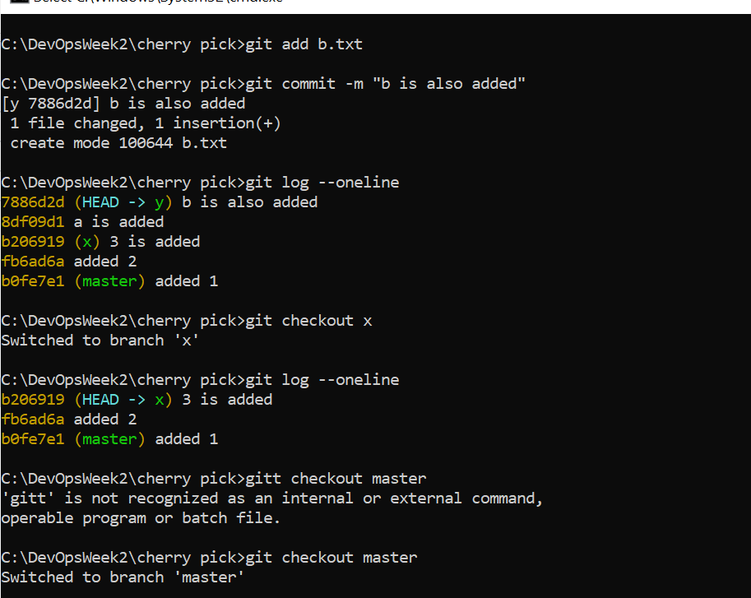
Cherry-pick (3)

Slide 10
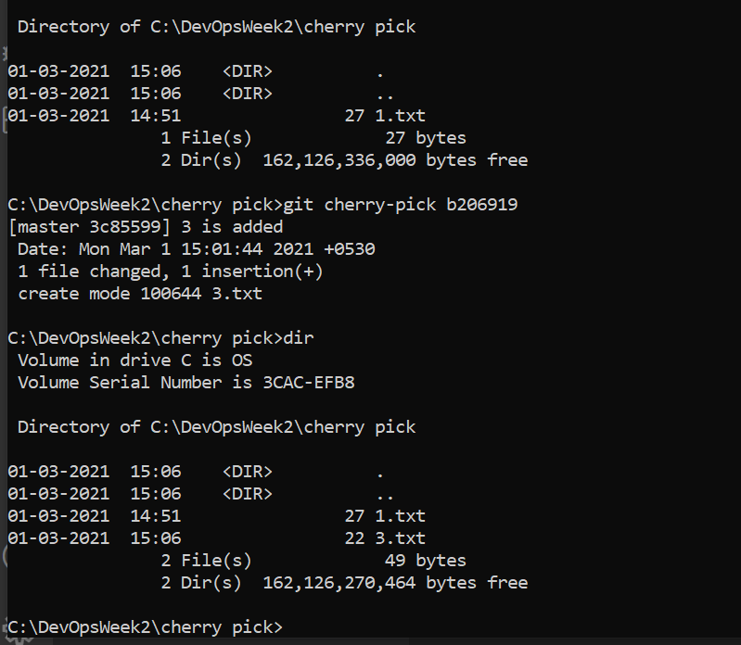
Cherry-pick (4)

Slide 11
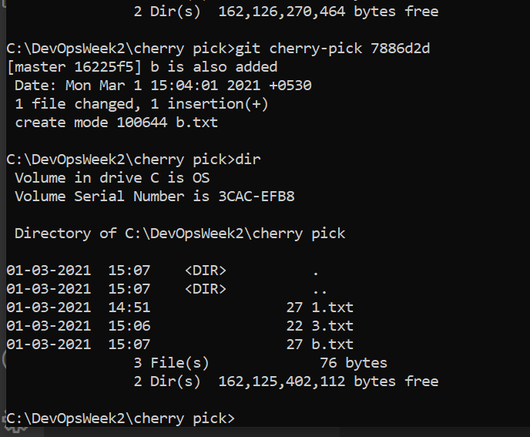
Cherry-pick (5)

Slide 12
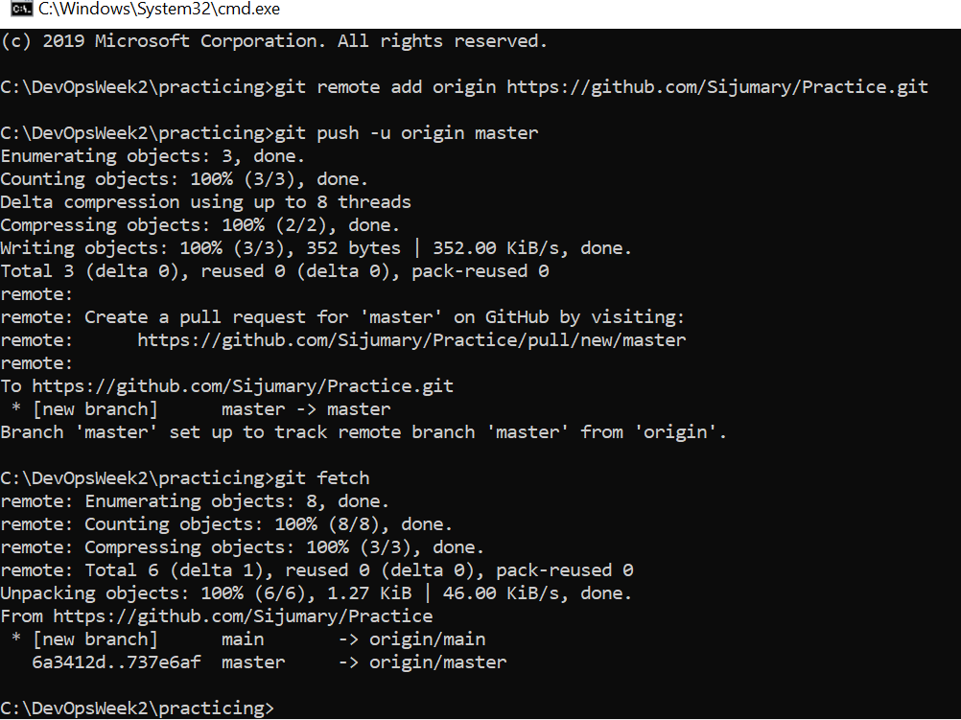
Fetch command

Slide 13
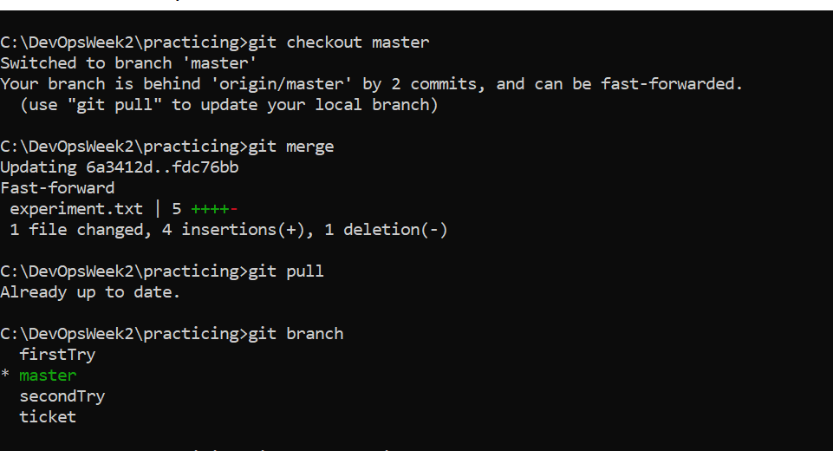
Merge and pull command

Slide 14
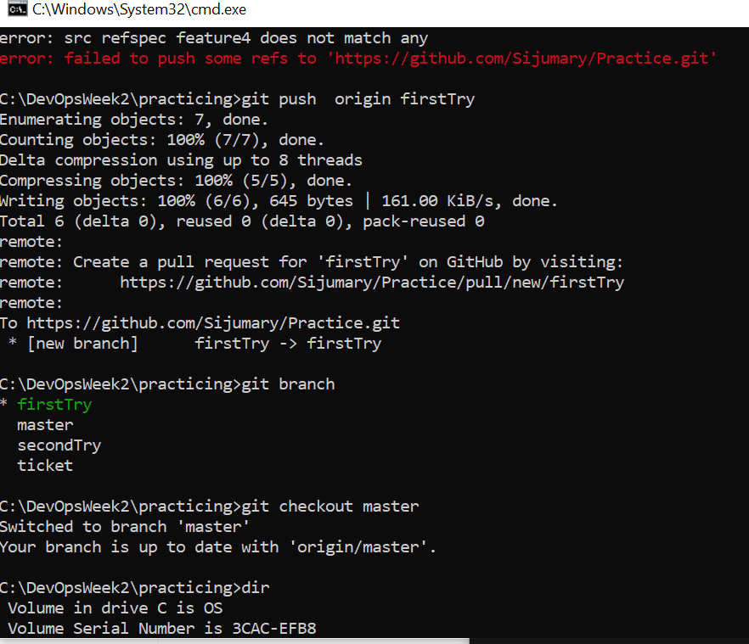
Pushing a branch to the repository

Slide 15
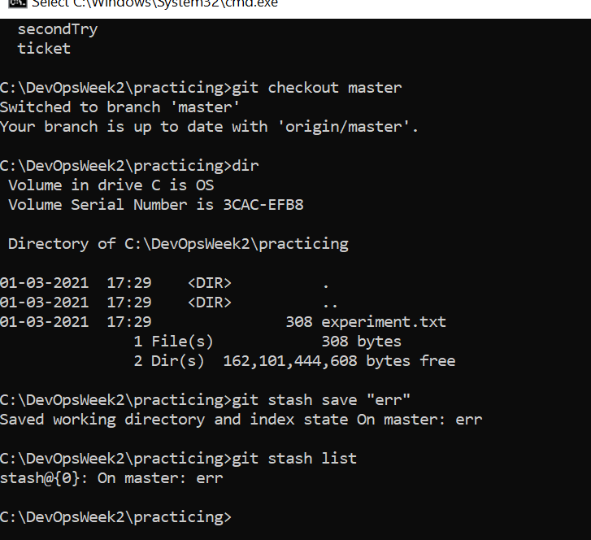
Stash commands

